Slide 1

Introduction to Deep Neural Networks
V. Srinivasa Chakravarthy

Slide 2

What are Deep Neural Networks?
Deep neural networks are:
MLPs with MANY hidden layers

Slide 3
A brief history…

Slide 4

Convolutional Neural Network (Yann LeCunn,1998)

Slide 5
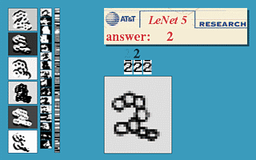
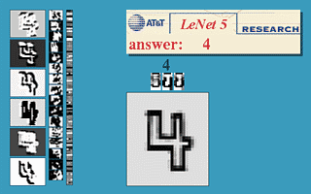
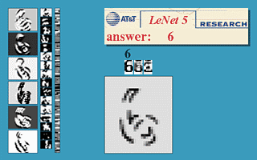
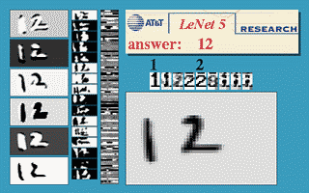
yann.lecun.com/exdb/lenet/

Slide 6
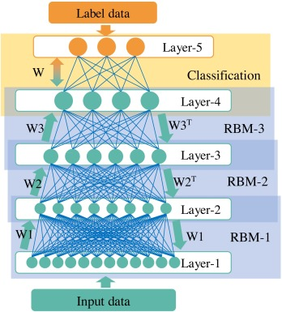
Deep Belief Networks (Hinton, Osindero, Teh, 2006)
Generalization of a
Restricted Boltzmann Machine
to multiple hidden layers
Rebranding MLPs as
DEEP Neural Networks

Slide 7

Large Scale Visual Recognition Challenge (2010) Fei-Fei’s Li’s group at Stanford

Slide 8

ALEX Net (Krizhevsky, Sutskever, Hinton 2012)
Best error performance in the first two years was around 25%
Alexnet achieved 16% error

Slide 9
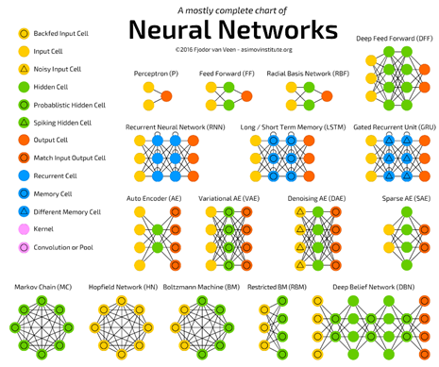

Slide 10
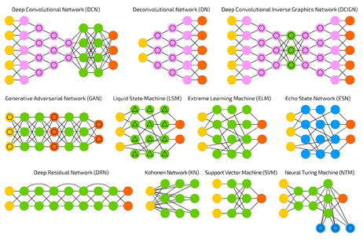

Slide 11
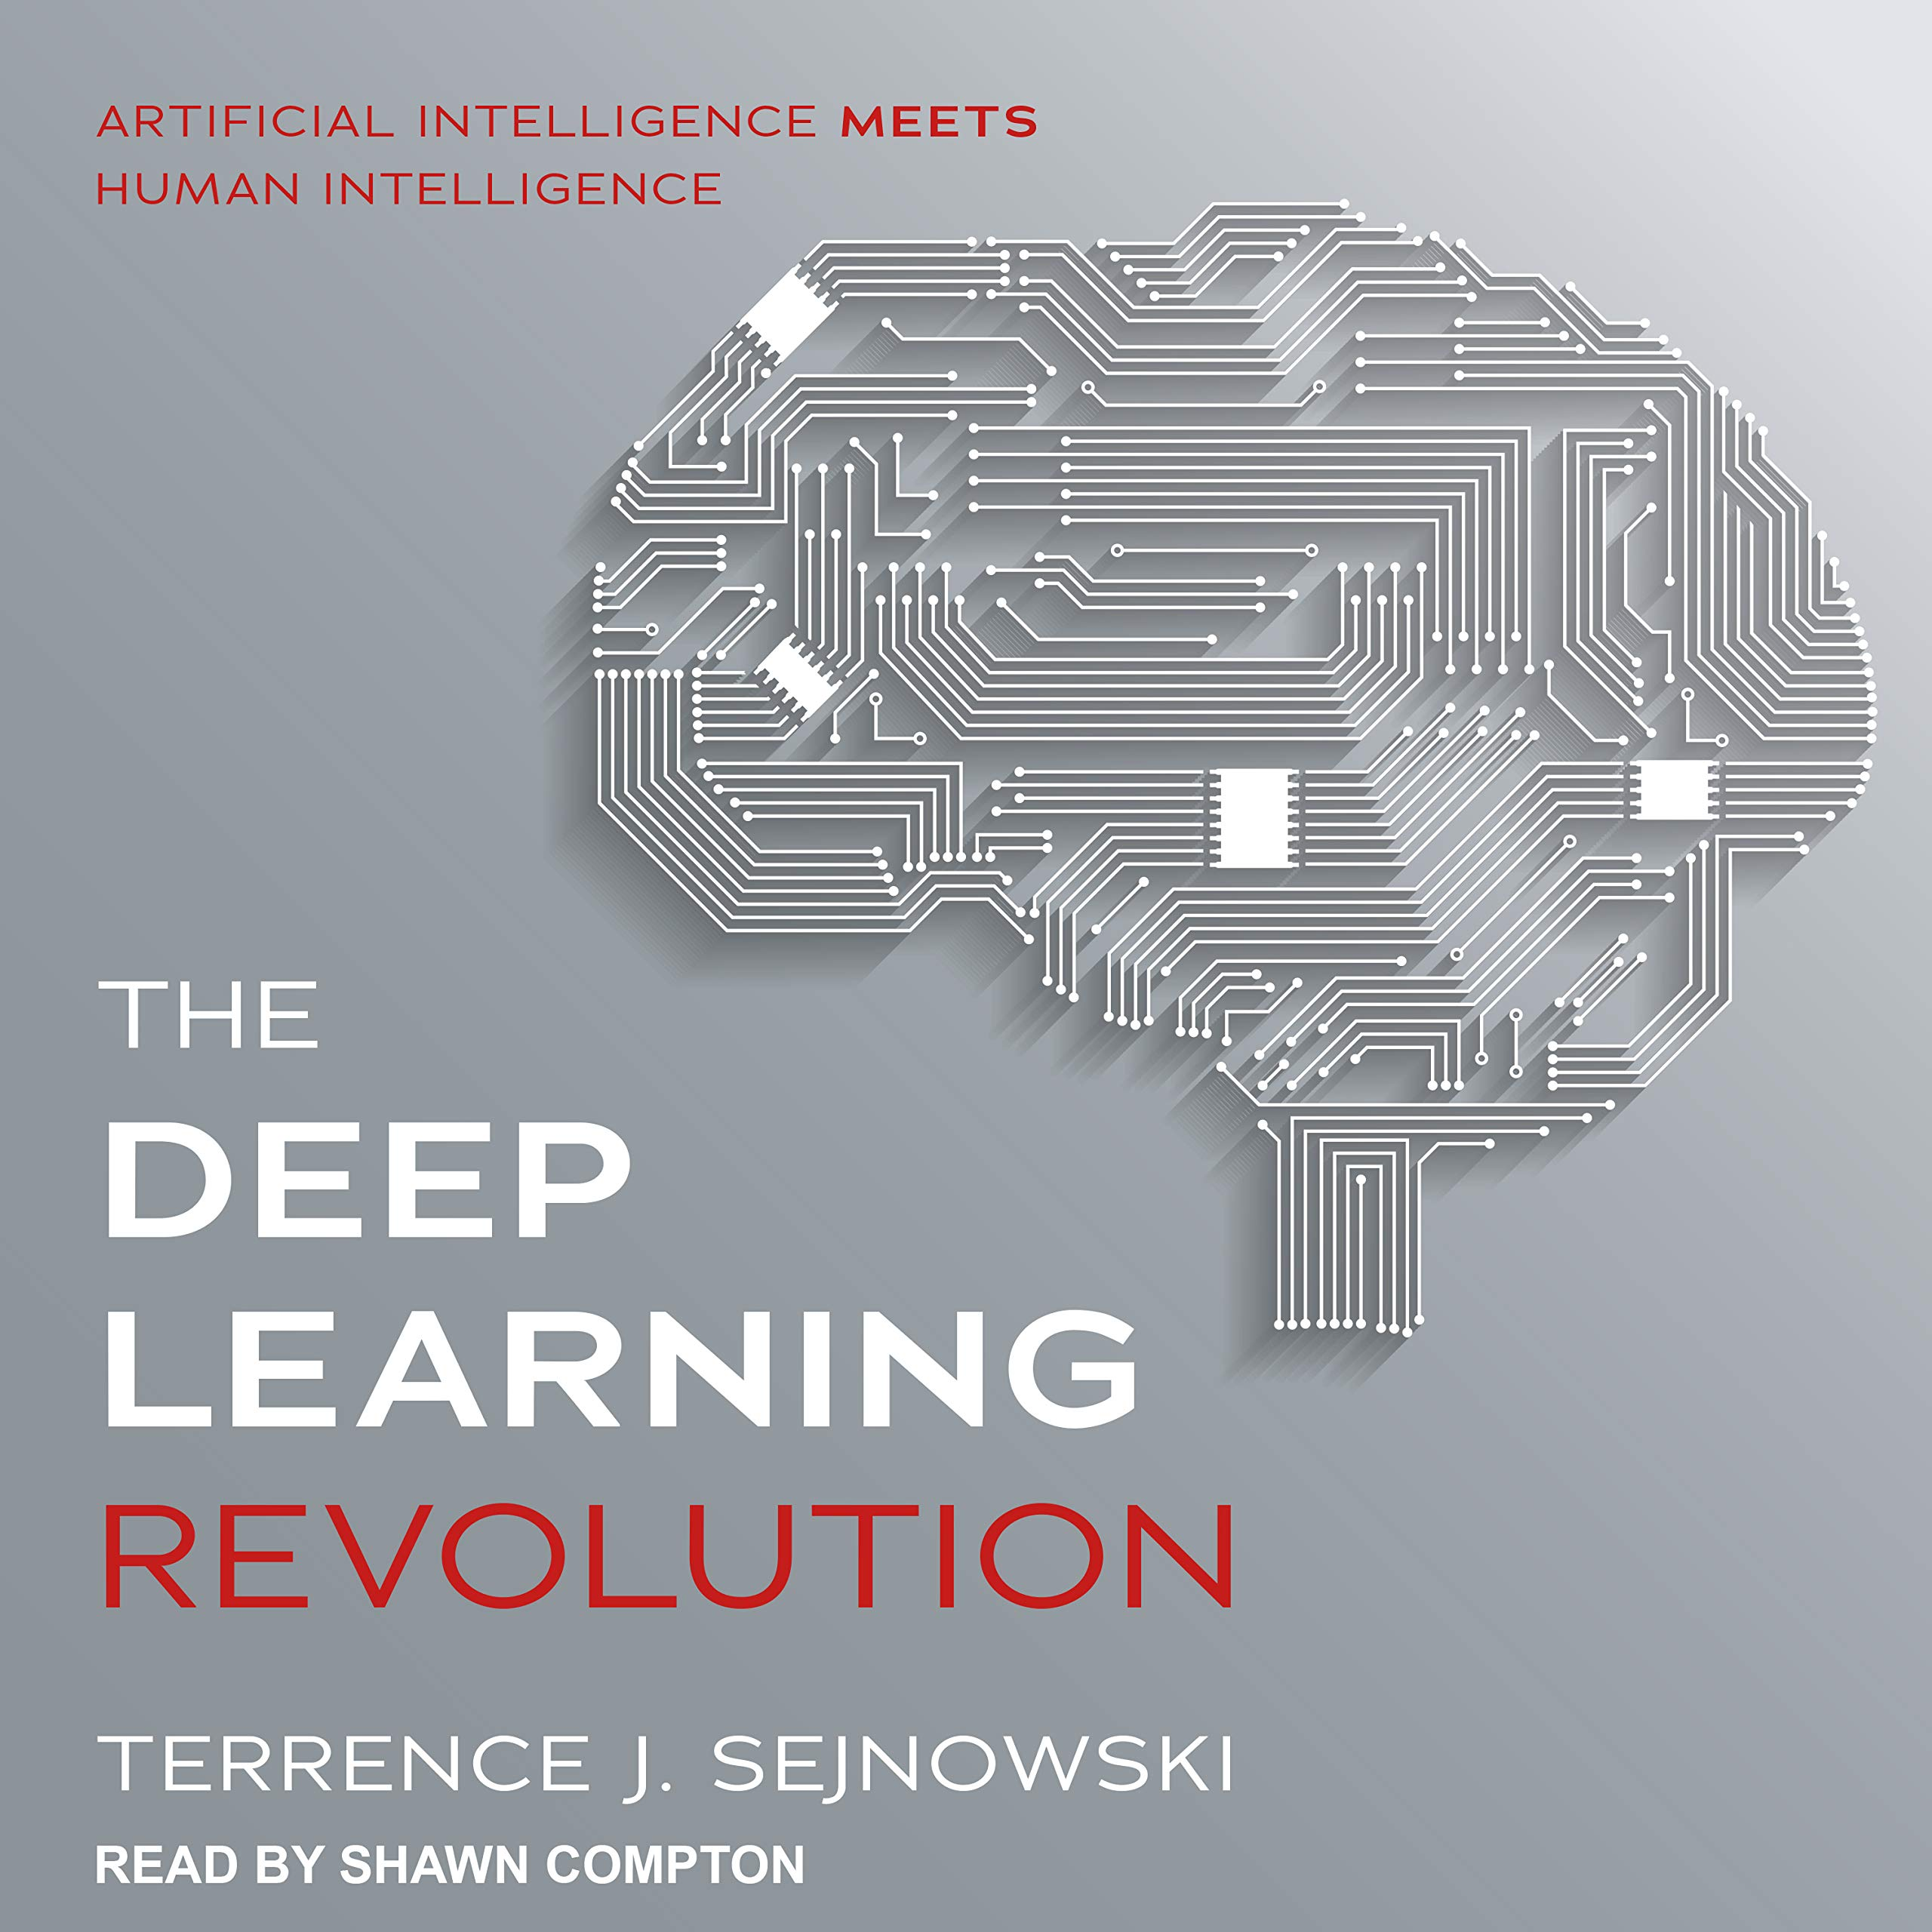
AI and Deep Learning Revolution

Slide 12
A Historical Irony
Artificial
Intelligence (AI)
Neural Networks

Slide 13
A Historical Irony
Artificial
Intelligence (AI)
Neural Networks
DEEP Neural Networks

Slide 14
A Historical Irony
In reality,
Deep Neural Networks are NOT AI
Artificial
Intelligence (AI)
!!!
Neural Networks
DEEP Neural Networks

Slide 15
Why deep neural networks
The Universal Approximation theorem states that a network with a single hidden layer but one that is sufficiently large can learn practically any function
Then why do we need Deep Neural Networks?

Slide 16
Reason #1
Sometimes DNNs give a more elegant structured solutions that a shallow (single hidden layer) network

Slide 17
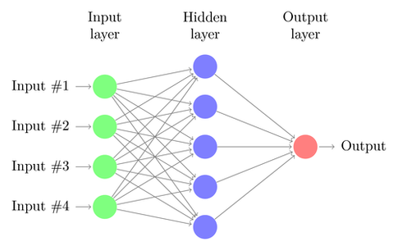
Example: parity problem
Parity problem: classify the number of 1s in a binary vector as odd/even.
Two class problem
Number of hidden neurons need with a single hidden layer MLP increases
Exponentially with the number of bits

Slide 18
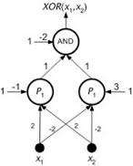
Shallow and Deep Networks for the Parity Problem
X1 | X2 | y
0 | 0 | 0
0 | 1 | 1
1 | 0 | 1
1 | 1 | 0
Two-bit parity problem = XOR problem
2BPMLP
A DNN -
How many hidden
Layers does it have?
2BPMLP
2BPMLP
2-bit parity MLP
(2BPMLP)
2BPMLP
2BPMLP
2BPMLP
2BPMLP
x1
x2
x3
x4
x5
x6
x7
x8

Slide 19
Reason #2
DNNs can learn interesting feature hierarchies
Lower layers learn simple features
Higher layers learn complex features

Slide 20


object models
Last layer learns nearly the entire face
Middle layer learns parts of the face
object parts
(combination
of edges)
Lowest layer learns edges
edges
pixels

Slide 21
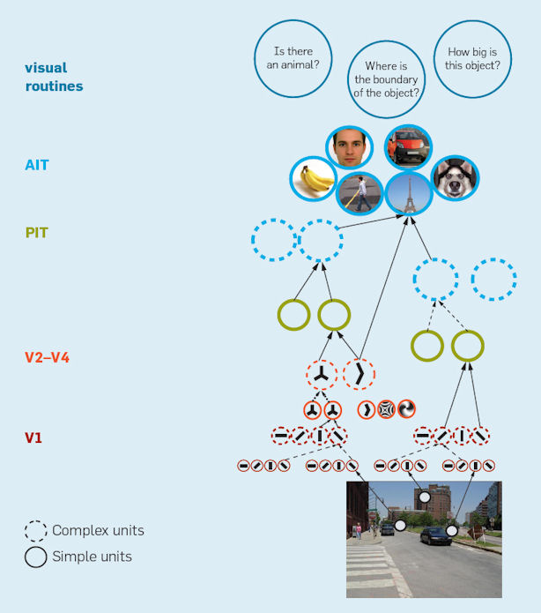
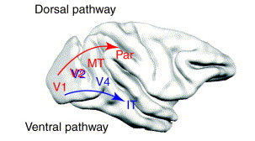
Hierarchical organization in the visual system

Slide 22
Hierarchical organization facilitates knowledge transfer
DNNs trained on numbers are able to recognize alphabets with only a little retraining

Slide 23
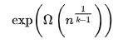
Reason #3
Hastad theorem
Boolean circuits of depth k in which only AND, OR, and NOT logic gates are used require size
for computing parity function.
Summary: For larger n, circuits with greater depth give more economical solutions

Slide 24
Reason #4
Gradient diffusion
Lower layer weights do not change much or change very slowly
g’() appears multiple times in delta calculation

Slide 25
Problem with MLP
It is hard to train large MLPs with backprop
Early attempts failed to yield encouraging results
Two approaches…

Slide 26
DNN training philosophy #1 (Hybrid learning approach)
Supervised learning
Unsupervised learning

Slide 27
DNN training philosophy #2
Supervised learning
By backpropagating error
All the way to the 1st hidden layer

Slide 28
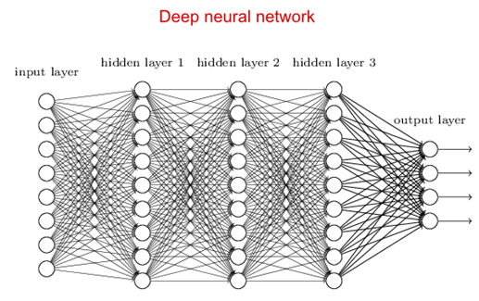
Hybrid Learning Approach
Train the lower layers using Unsupervised Learning
Train only the last weight stage using Supervised Learning
Unsupervised Learning
Supervised Learning

Slide 29
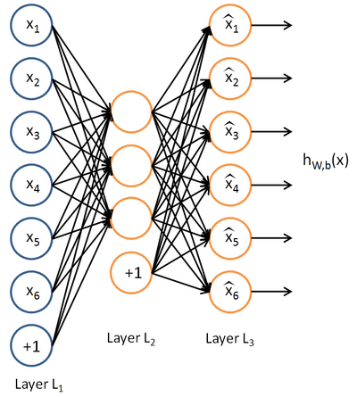

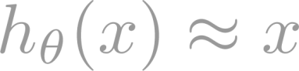
Unsupervised feature learning with a neural network
Autoencoder.
Network is trained to output the input (learn identify function).
Trivial solution unless:
Constrain number of units in Layer 2 (learn compressed representation), or
Constrain Layer 2 to be sparse.
a₁
a₂
a₃

Slide 30
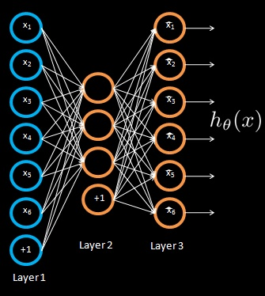
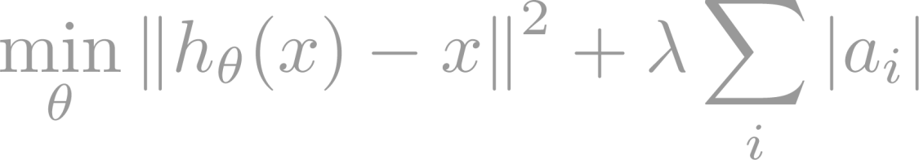
Unsupervised feature learning with a neural network
Training a sparse autoencoder.
Given unlabeled training set x₁, x₂, …
a₁
a₂
a₃
Reconstruction error term
L₁ sparsity term

Slide 31
Remove the second hidden layer

Slide 32
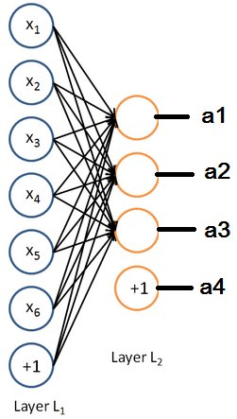

Slide 33
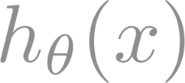
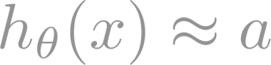
Unsupervised feature learning with a neural network
x₁
x₂
a₁
b₁
x₃
a₂
b₂
x₄
a₃
b₃
x₅
+1
+1
x₆
+1
Train parameters so that ,
subject to b_{i}’s being sparse.

Slide 34
Unsupervised feature learning with a neural network
x₁
x₂
a₁
b₁
x₃
a₂
b₂
x₄
a₃
b₃
x₅
+1
+1
x₆
+1
Train parameters so that ,
subject to b_{i}’s being sparse.

Slide 35

Unsupervised feature learning with a neural network
x₁
x₂
a₁
b₁
x₃
a₂
b₂
x₄
a₃
b₃
x₅
+1
+1
New representation for input.
x₆
+1

Slide 36
Unsupervised feature learning with a neural network
x₁
x₂
a₁
b₁
x₃
a₂
b₂
x₄
a₃
b₃
x₅
+1
+1
x₆
+1

Slide 37
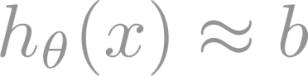
Unsupervised feature learning with a neural network
x₁
x₂
a₁
b₁
c₁
x₃
a₂
b₂
c₂
x₄
a₃
b₃
c₃
x₅
+1
+1
+1
x₆
+1

Slide 38

Unsupervised feature learning with a neural network
x₁
x₂
a₁
b₁
c₁
x₃
a₂
b₂
c₂
x₄
a₃
b₃
c₃
x₅
+1
+1
+1
x₆
+1

Slide 39

Unsupervised feature learning with a neural network
x₁
x₂
a₁
b₁
c₁
x₃
a₂
b₂
c₂
x₄
a₃
b₃
c₃
x₅
+1
+1
+1
New representation
for input.
x₆
+1
Use [c₁, c₃, c₃] as representation to feed to learning algorithm.

Slide 40
Unsupervised feature learning with a neural network
x₁
x₂
a₁
b₁
c₁
d₁
x₃
a₂
b₂
c₂
d₂
x₄
a₃
b₃
c₃
d₃
x₅
+1
+1
+1
x₆
+1
Supervised Learning
- LMS, SVM etc
Use [c₁, c₃, c₃] as representation to feed to learning algorithm.

Slide 41


